Slide 1



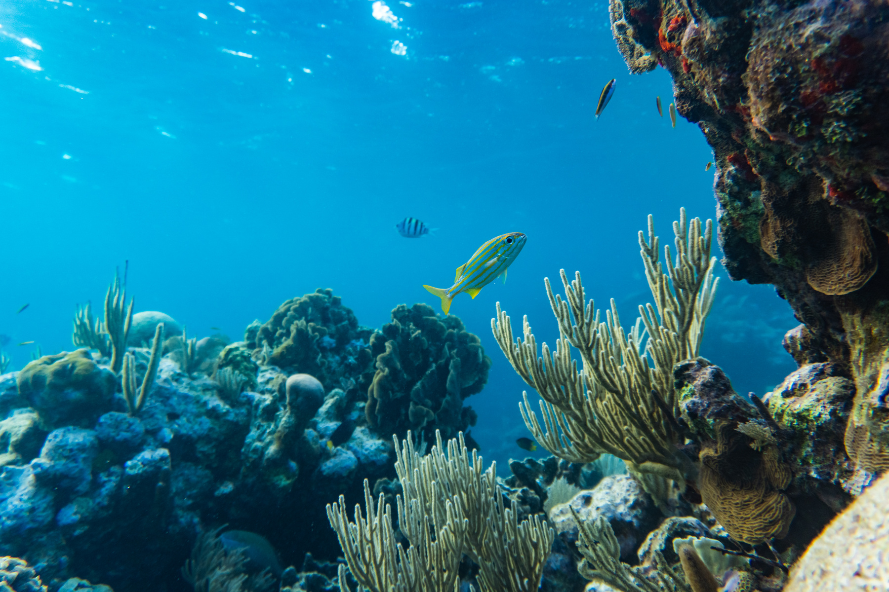
Innovative Sparkes
Fishermen still rely on guesswork, leading to wasted fuel, lost time, and unsafe or illegal navigation. Without real-time data, they face declining catches and unsustainable practices. No existing tool offers an offline-capable, all-in-one solution.
1) MADHAV R
2) KRISHNA N
2) MIRACLINE GLADYS J
3) KARTHIKA V

Slide 2




Introduction to Solution
SMARTNAVFISH
SmartNavFish is an AI-driven marine navigation system designed for fishermen. It uses satellite data, GPS, and machine learning to generate fish heatmaps, optimize fuel-efficient routes, provide real-time alerts for marine boundaries, and enable SOS-based emergency response. The system enhances efficiency, reduces costs, ensures legal compliance, and improves safety at sea

Slide 3






Tech Stack
Feature | Technology Used
Real Time Maps | Mapbox GL JS + PostGIS
AI Predictions | Scikit-learn + TensorFlow Lite
Offline Mode | SQLite + Hive (Flutter)
SOS System | Twilio API + Firebase
Weather Data | OpenWeatherMap + World Tides API
Authentication | JWT + OAuth2

Slide 4

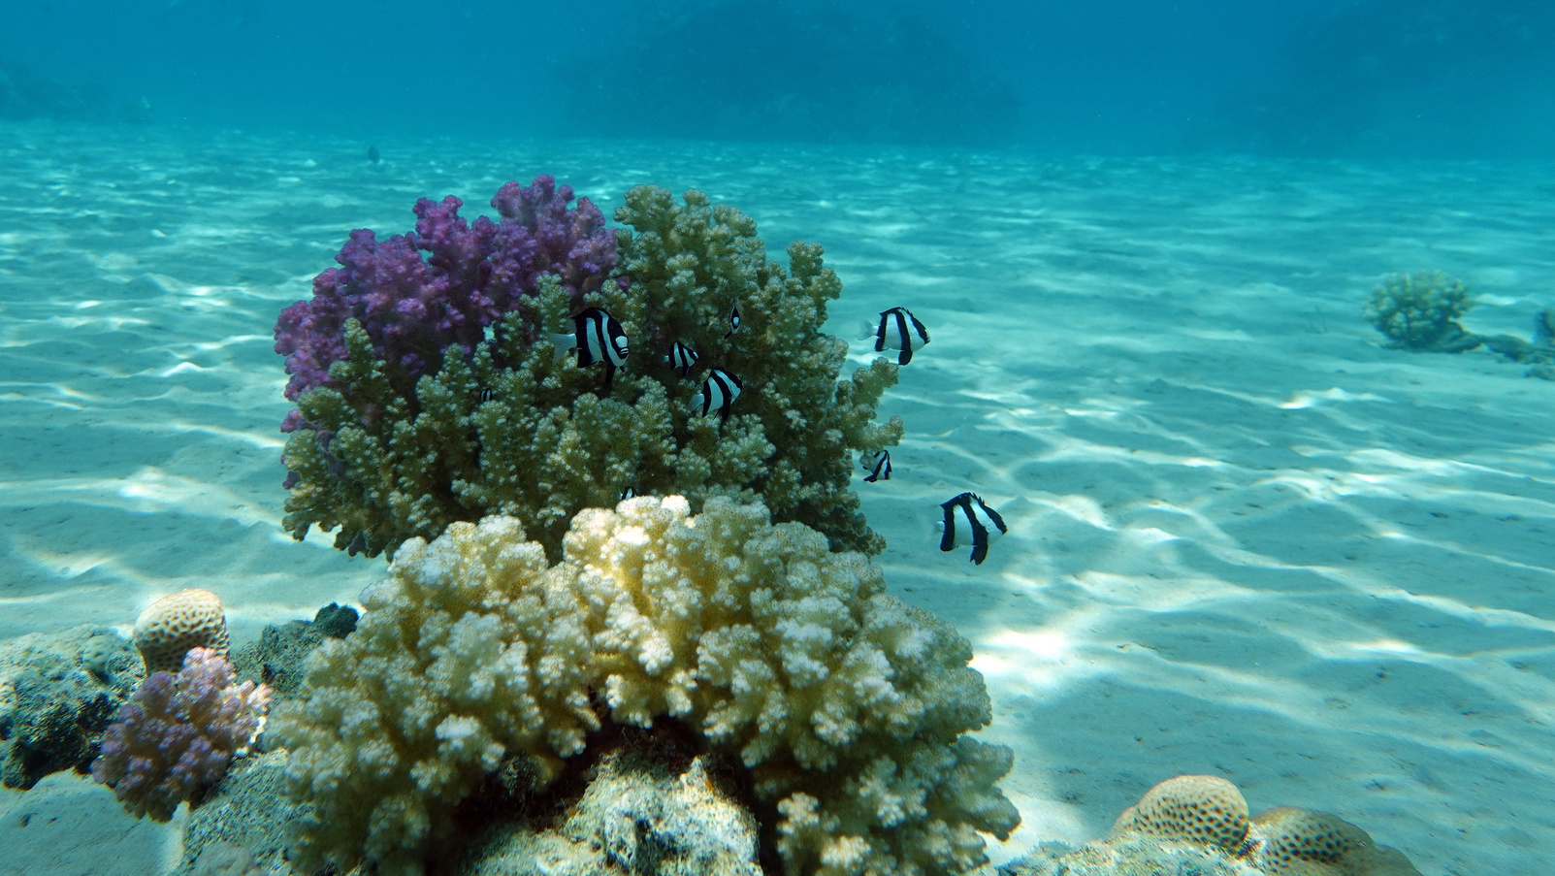
Demo Video
https://youtu.be/NG8_-_fMKC0

Slide 5
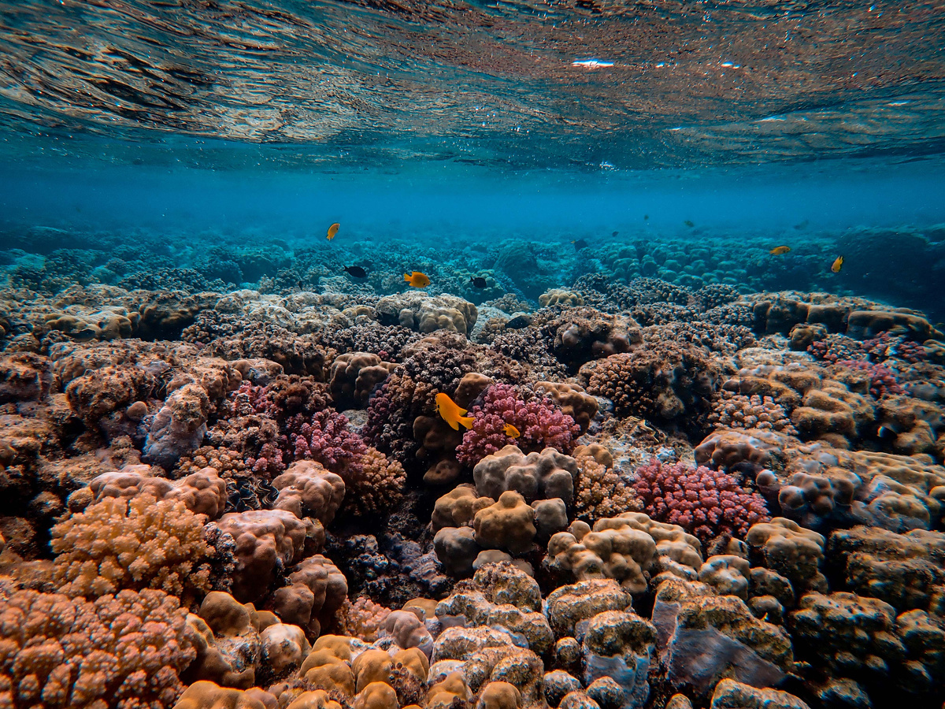
Business Analytics
SmartNavFish for coastal and deep-sea fishermen to optimize routes, save fuel, follow marine laws, and ensure safety at sea
Scalability
Can scale from small fishermen groups to national fisheries.
Expandable to aquaculture, inland fishing, and global coasts.
App-based, compatible with low-cost smartphones + GPS trackes
Impact
Market Potential
40% time saved
Fuel usage reduced
Fewer legal violations
Lives saved via SOS
India: ~4 million active fishermen
Government & NGO support for sustainable fishing and digital empowerment.

